Slide 1


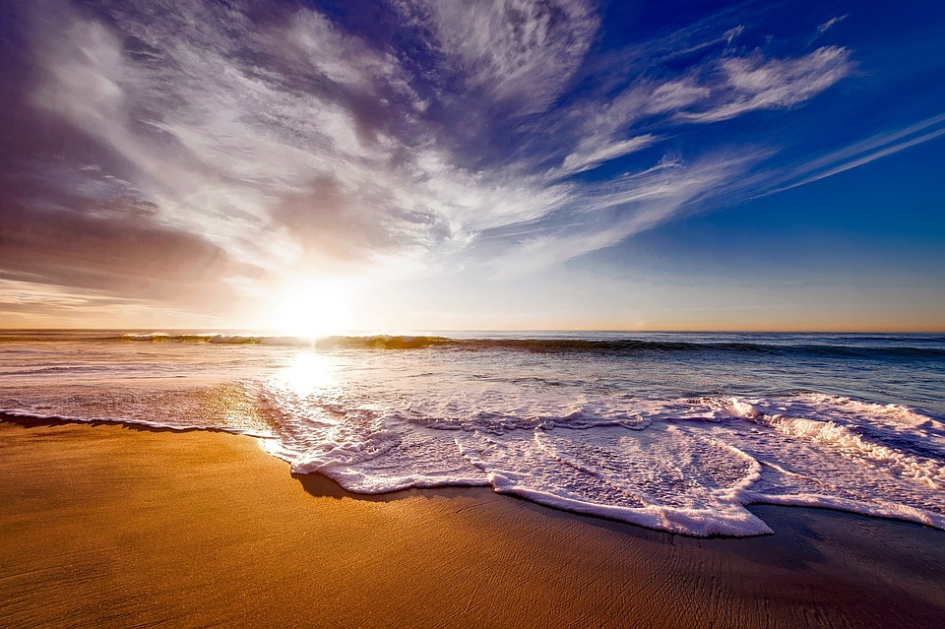
Introductory Meeting with Internal Georgian College team
MIC
Smart Beach
CRYdata Solutions:
Cassandra Forlani
Ruwindhu Dilanga Chandraratne Hettige Don
Yi-Chen Hsiao
Notes:
Image: 12019 (2016) Ocean waves crashing on shore during daytime https://pixabay.com/photos/beach-sea-sunset-sun-sunlight-1751455/

Slide 2

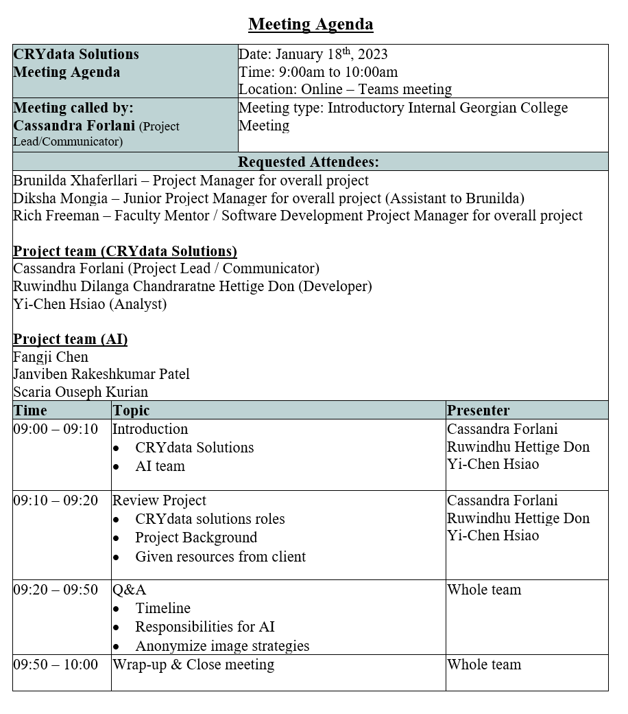
Agenda
Notes:
Image: from free image website - unsplash (https://unsplash.com/)

Slide 3


Introduction
Notes:
Image: from SAOLA SHOES website (https://saolashoes.com/)

Slide 4
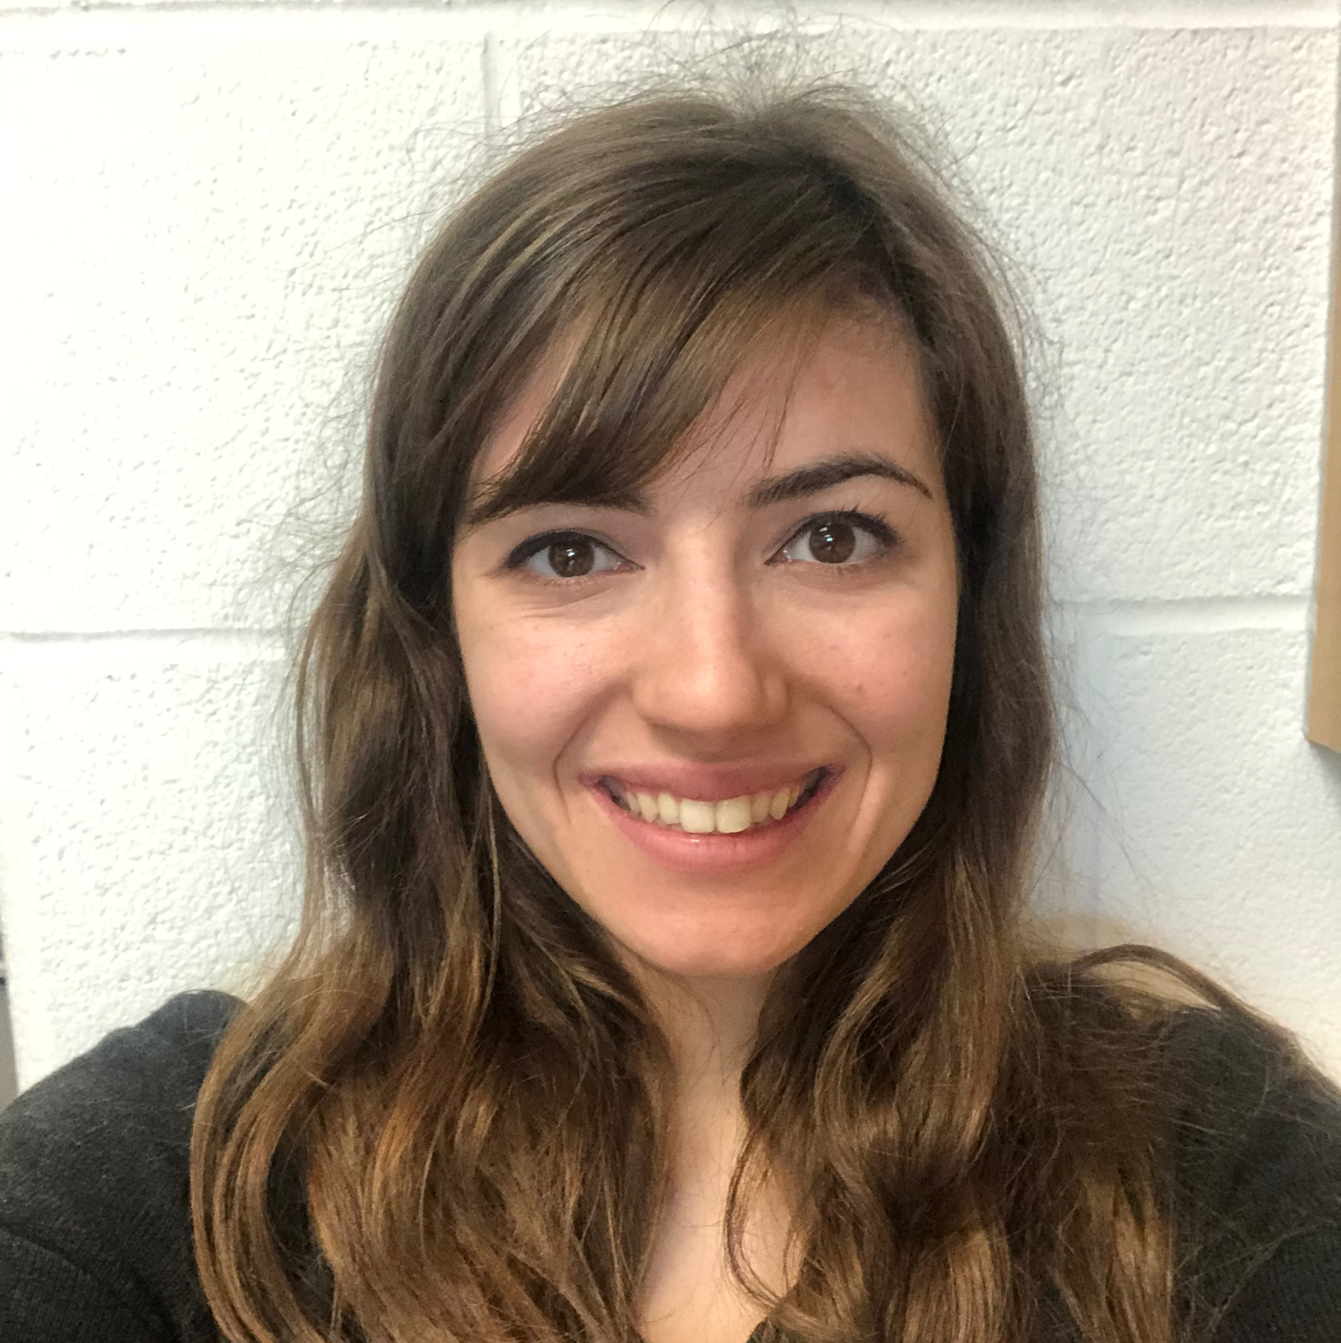
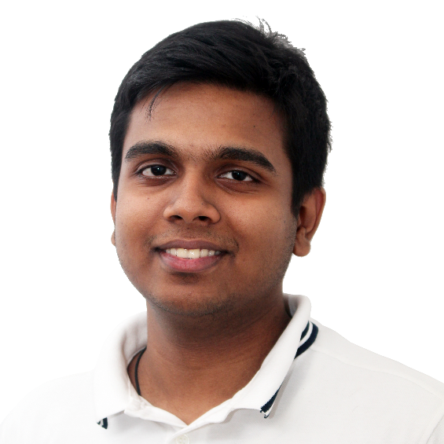
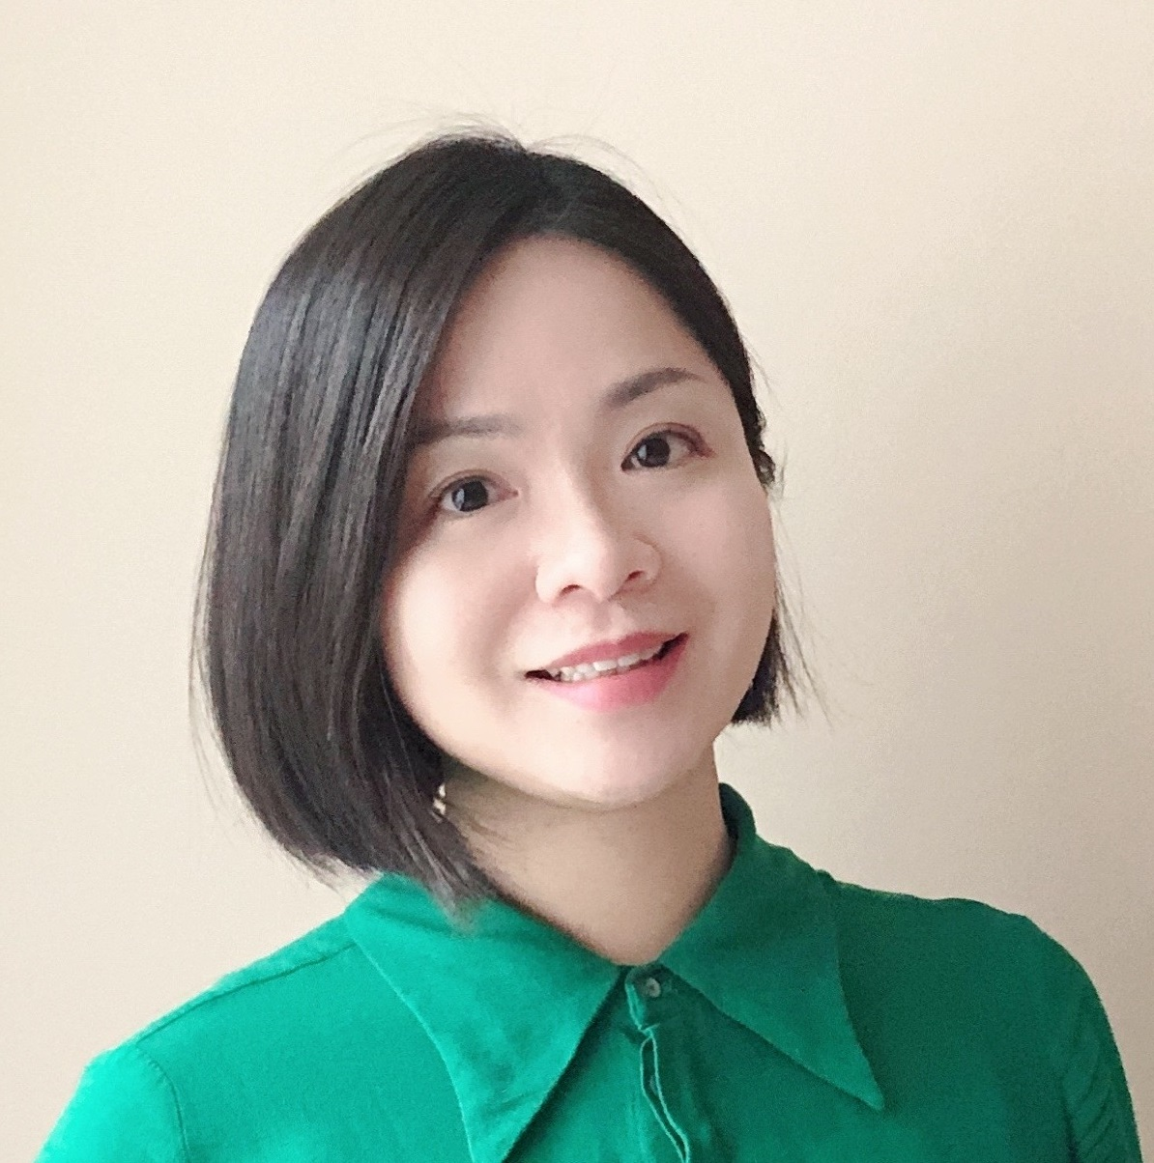
CRYdata Solutions
Our Team
Cassandra
Forlani
Ruwindhu Dilanga Chandraratne Hettige Don
Yi-Chen
Hsiao
Project Lead / Communicator
Developer
Analyst

Slide 5

Who we are
I have a Bachelor of Math from Waterloo University and a Bachelor of Education from Western University. Prior to the Big Data Analysis program at Georgian College, I was a high school math teacher. In terms of skills, I have high communication and organization with entry level experience in Python, Apache-Hive, R, Power BI and Report Builder. I look forward to this project and our future weeks together.
LinkedIn: https://ca.linkedin.com/in/cassandra-forlani
I have a Bachelor’s in Software Engineering and Post Graduate Certificate in Artificial Intelligence. Prior to the Big Data Analytics Program at Georgian College, I have experience using Python for Machine Learning and Neural Networks. In addition to this, I have 2 years of experience working as a Software Engineer where I worked with different programming languages such as C++ and C#. In terms of skills, I have worked in many agile teams and have a thorough understanding of agile development processes.
LinkedIn: https://ca.linkedin.com/in/ruwclk
I earned my Ph.D. in the health science field in 2018 in Taiwan, with a solid quantitative and qualitative methods training background, and I have some articles published in international journals (SSCI/SCI). Before studying in the BDAT program, I accumulated many years of experience helping clients make data-driven decisions. Additionally, I co-founded a non-profit in Taiwan, helping entrepreneurs make good use of data. I am adept at market research and predictive models and familiar with various tools (SPSS, Python, R, Power BI, Apache-Hive).
LinkedIn: https://ca.linkedin.com/in/yi-chen-hsiao

Slide 6
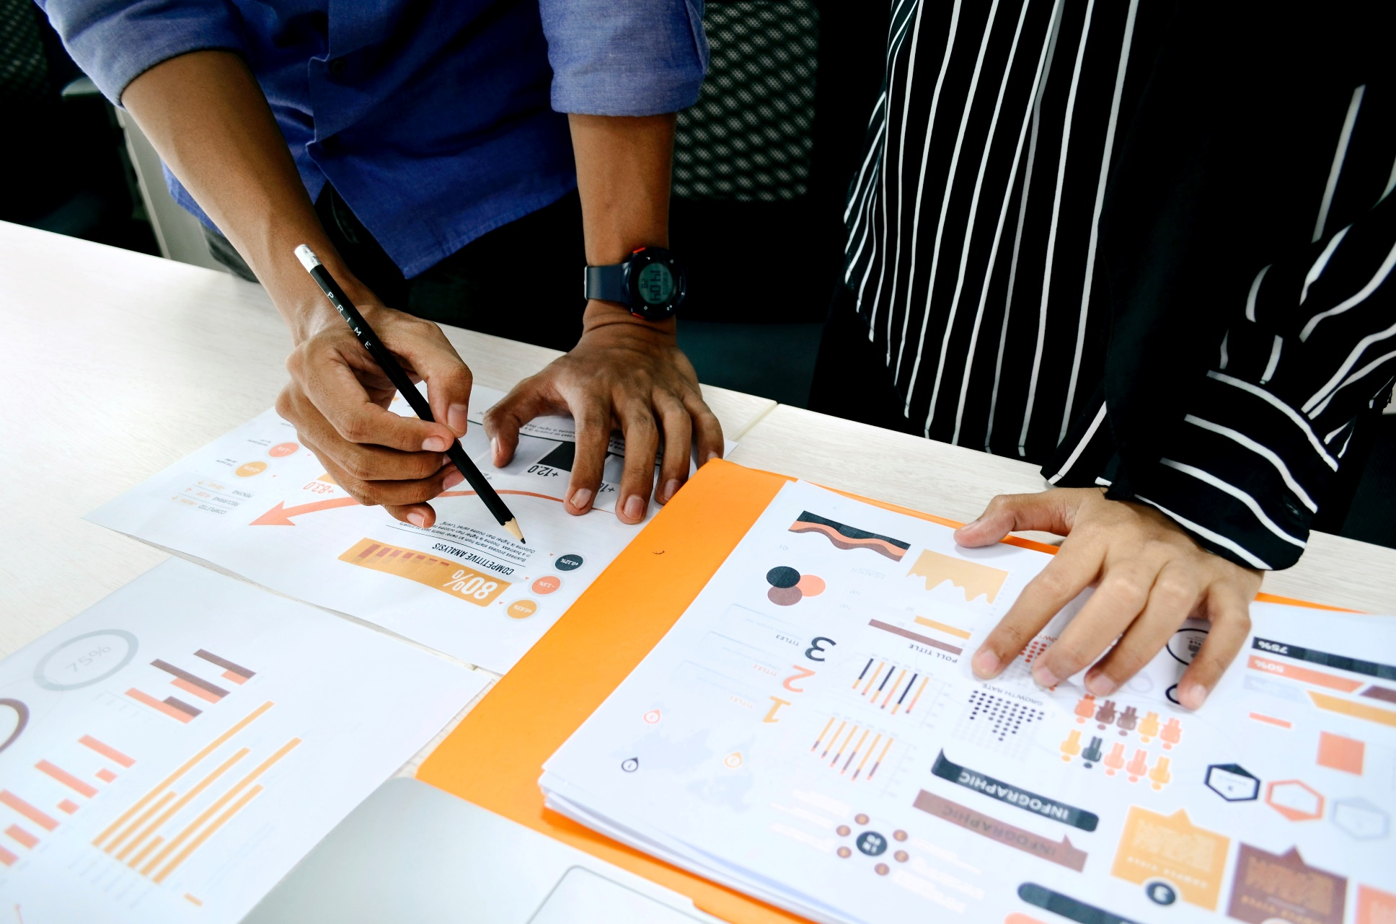
Project Overview
Notes:
Image: from free image website - unsplash (https://unsplash.com/)

Slide 7
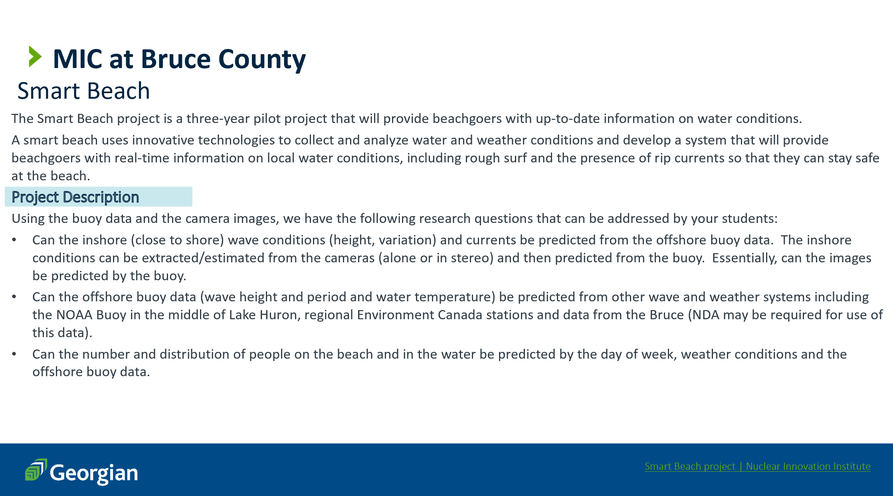

Slide 8
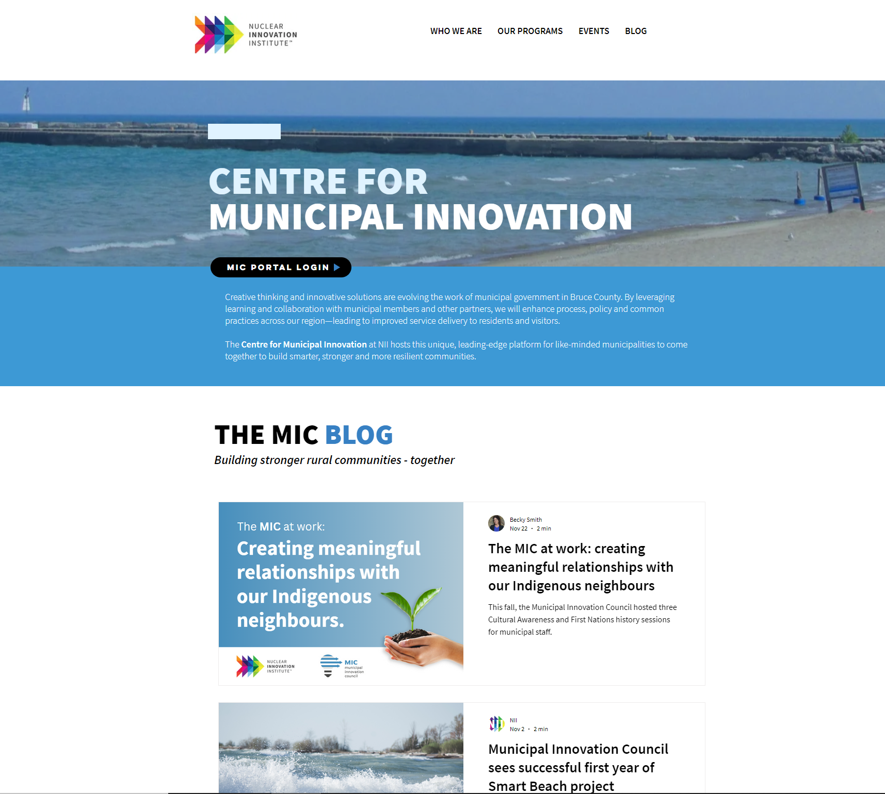

External Research via The MIC Blog
Warning system
Provides safety notice to beachgoers
Includes information regarding local water conditions, rough surf and presence of rip currents
Machine learning
Will use wave, current and wind data accumulated with a RAEON buoy
Anonymized images to understand how wave conditions affected peoples use of water and if beach access design strategies promoted safer water activities
NII Centre For Municipial Innovation - The MIC BLOG https://www.nuclearinnovationinstitute.ca/municipal-innovation
NII (Nov 2, 2022) Municipal Innovation Council sees successful first year of Smart Beach project https://www.nuclearinnovationinstitute.ca/post/municipal-innovation-council-sees-successful-first-year-of-smart-beach-project

Slide 9

What MIC gave us:
Question 1: Can we predict the inshore significant wave height, wave period, wave direction, current speed, and temperature profile using readily available weather and wave data from NDBC buoys in Lake Huron as well as weather stations managed by Environment Canada and NOAA. Part of this question is balancing the amount of data with the confidence in the prediction. Data provided: wave, temperature, and current data from the buoy.
Data needed: Weather and wave data from NOAA and Environment Canada.
Question 2: Using the above model, we would like to predict the wave, current and temperature conditions for past drownings and rescues at Kincardine and along the Huron shore of Bruce County.
Data needed: Historical Weather and wave data from NOAA and Environment Canada.
Question 3: Predict the wave conditions and current visible in the camera images, as well as the number and distribution of people on the beach and in the water.
Data provided: anonymized images from the camera. This will be provided later once the images are anonymized, with a focus on providing the model set first.
Comment from Dr. Houser - Knowing that we have 3-4 months, our focus is on Questions 1 and 2.
Notes:
Content Pixie (n.d.) Mug, Watch, and Planner Book on Brown Wooden Surface. Accessed on December 6th, 2022, from https://www.pexels.com/photo/mug-watch-and-planner-book-on-brown-wooden-surface-2736499/

Slide 10

Thank you!
Questions?
Notes:
Image: Leloo, The first (2022) https://www.pexels.com/photo/question-marks-on-paper-crafts-5428833/

